Slide 1
WebEx Contact Center Analyzer Reporting

Slide 2
Agenda
Analyzer Overview
Analyzer Visualization
Data Output Formats
Visualization Variables
Analyzer Scheduler
Analyzer Dashboard

Slide 3

Analyzer Overview

Slide 4
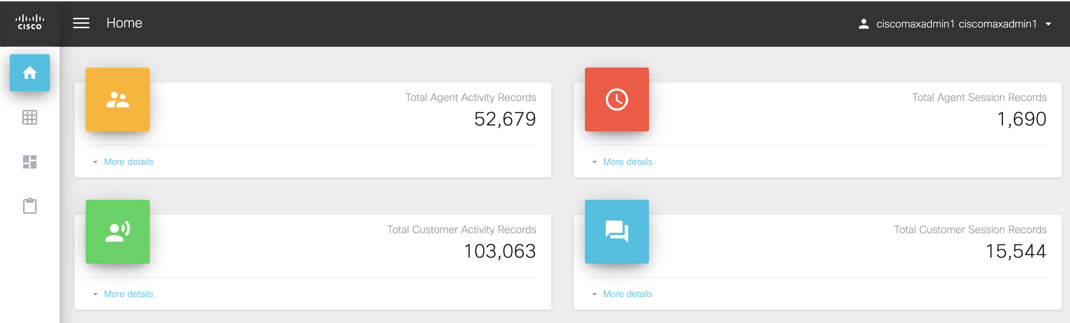
Cisco Journey Analyzer
Reporting & Analytics for Webex CC
Native Cloud reporting platform for Webex CC
Stores as Customer Interaction & Agent Activity records
Out of box Standard Historical & Real-time reports/Dashboards
Out of box Business Analytical Insights
Schedule reports
Supports Chart & tabular reports
Export report as .CSV & Excel to do further analysis
Dashboard Capabilities for single view of multiple Historical and Realt-time reports
Distribute via Excel, CSV or link embedded in email

Slide 5


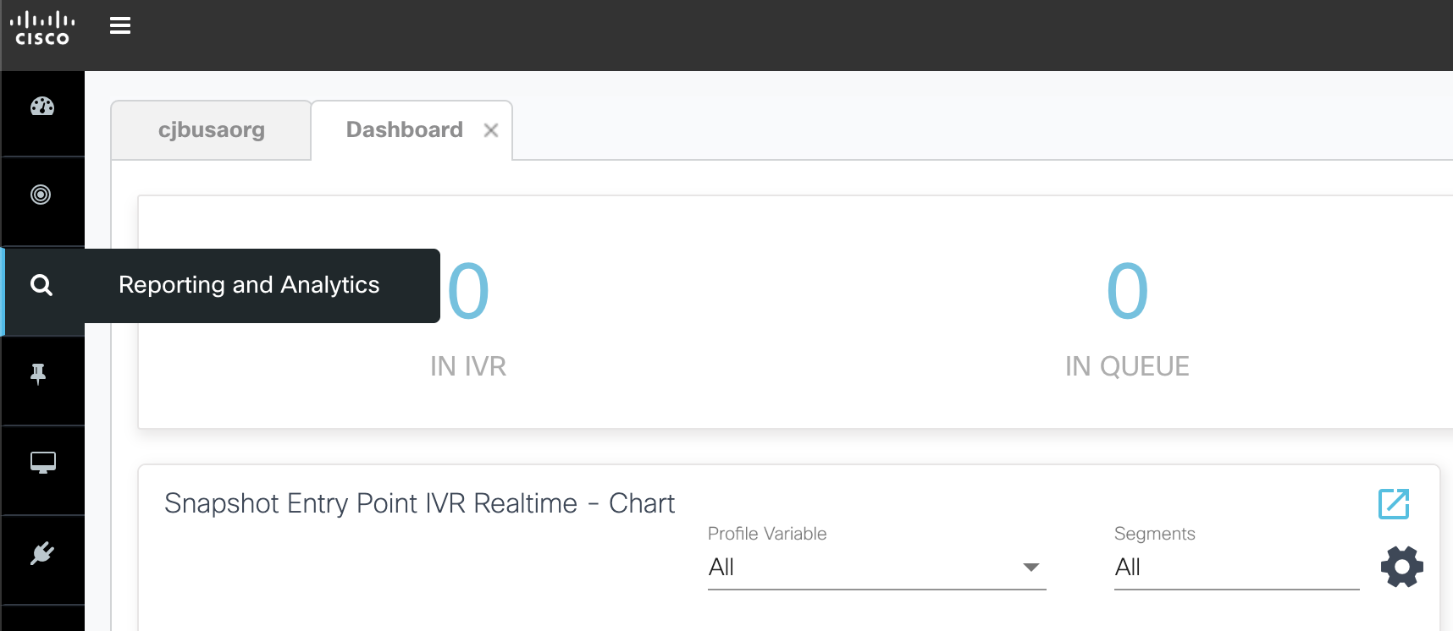
Analyzer Access
From Portal, navigate to ‘Reporting and Analytics’
User Entitlement via Control Hub
Access using Cross Launch From Webex Contact Center Management Portal:
https://portal.cjp.cisco.com/portal/home.html
https://analyzer.cjp.cisco.com/analyzer/home
Access using using Direct Link:
Browser | Microsoft Windows 10 | Mac OS X | Chromebook
Google Chrome | 76.0.3809 | 76.0.3809 or higher | 76.0.3809 or higher
Mozilla Firefox | ESR 68 and higher ESRs | ESR 68 and higher ESRs | NA
Microsoft Edge | 42.17134 | NA | NA
Chromium | NA | NA | 73 or higher
Ensure the browser pop-ups enabled
Ensure to install Adobe Flash Player (for motion Chart)

Slide 6
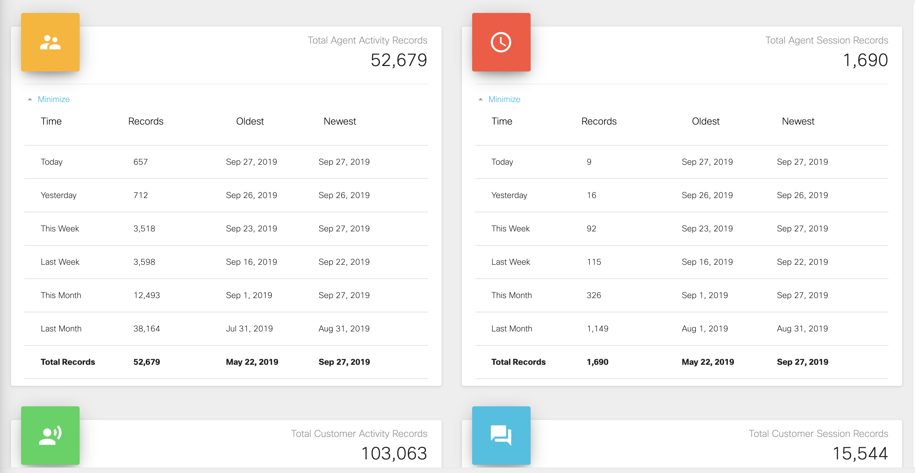
Analyzer Record Type
Choose the record type of the visualization
Customer Session Record
Customer Activity Record
Agent Session Record
Agent Activity Record

Slide 7
Analyzer Visualization

Slide 8
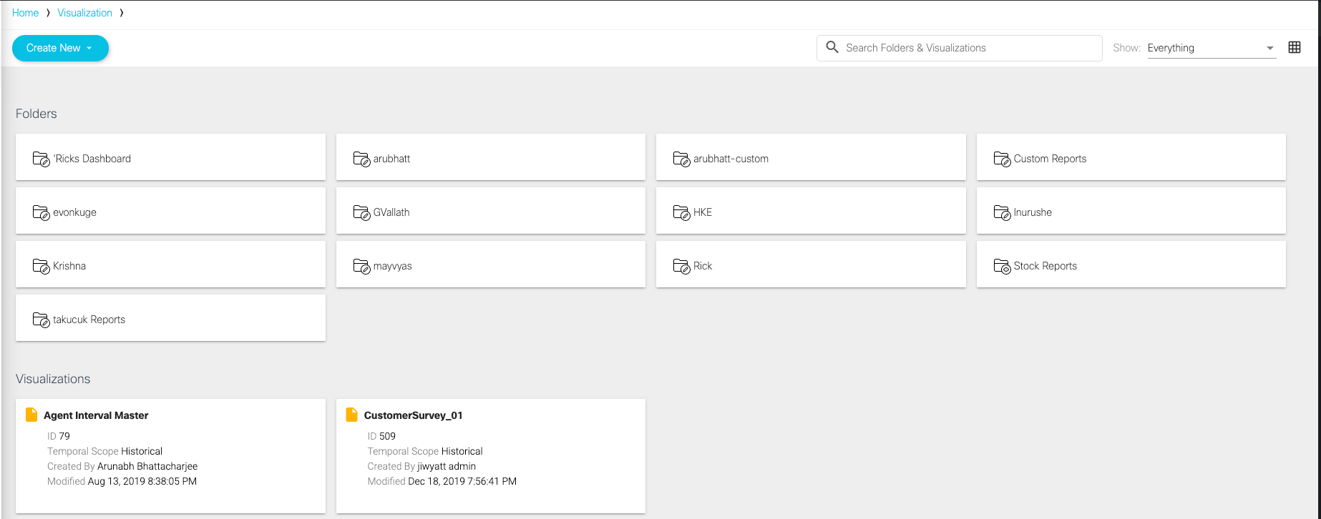
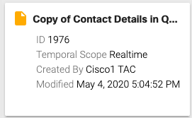
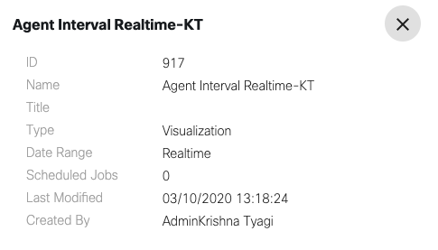
Analyzer Visualization
Search Folder and Visualization
Visualization Summary
List or Grid View
Details
Temporal Scope
Created By
Modified Date/Time

Slide 9
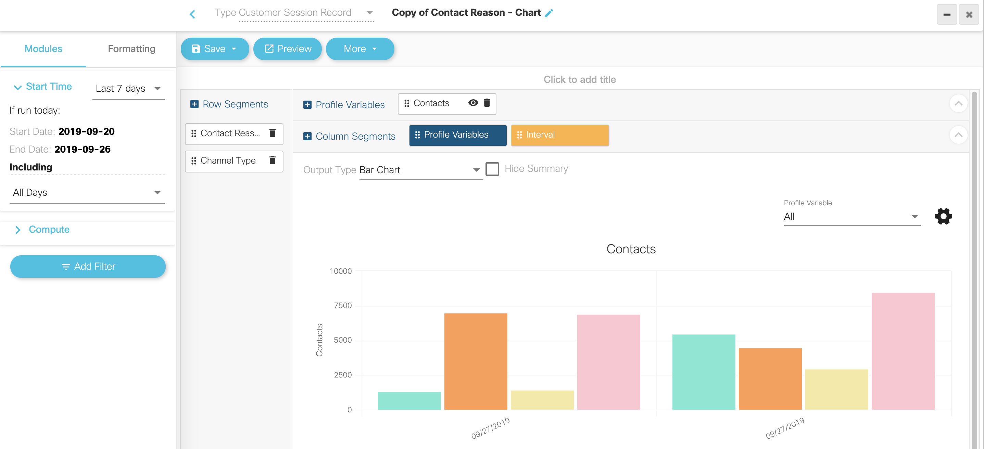
Analyzer Visualization
Create Visualization/Reports
Create operational metrics on Analyzer
Drag & drop fields
Formulae on fields
Filter data based on other fields/date-time ranges
Add to Dashboard
Change Charts on the fly
Bar, Line, Column
Heatmaps
Motion charts show trends

Slide 10

Create Visualization
Structure
Type or Repository:
CSR, CAR, ASR, AAR
Time Period: Realtime or Historical
Interval
Output Type: Table, Heatmap, Chart
Defines the data set
Profile Variables:
Field, Measures and Formulas
Value or Count Report
Row Segment
Fields, Enhanced Fields
Filter
Fields, Measures

Slide 11
Data Output Formats

Slide 12
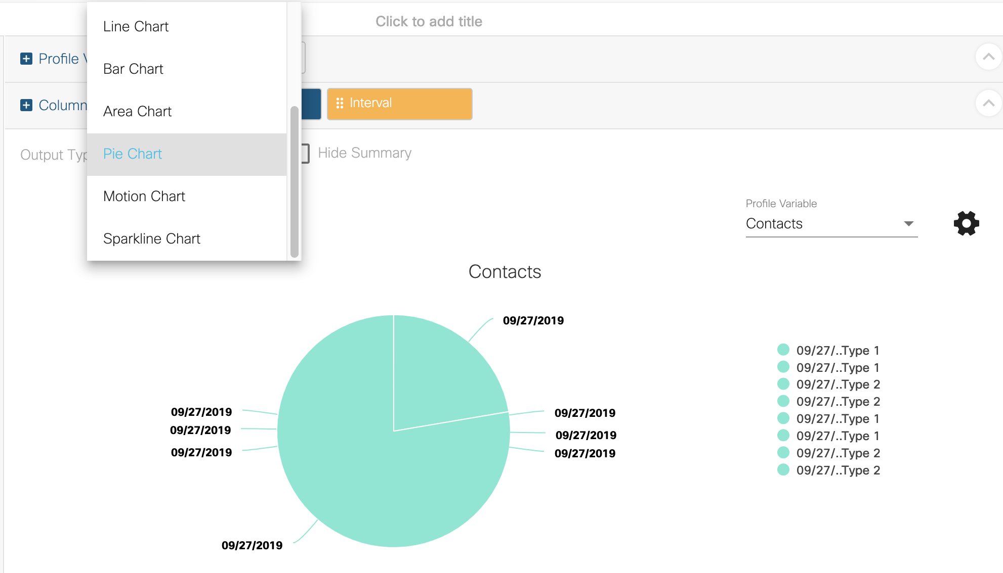
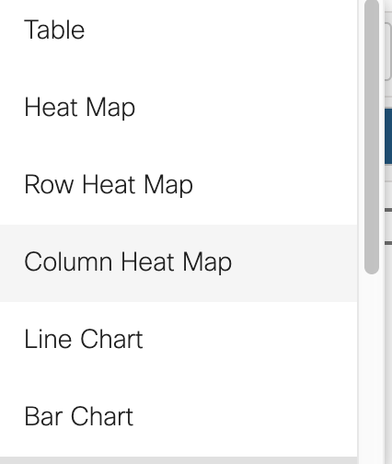
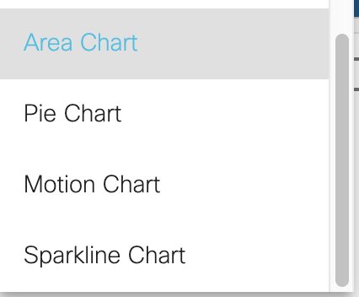
Data Output Formats
The data can be displayed as:

Slide 13
Visualization Variables

Slide 14
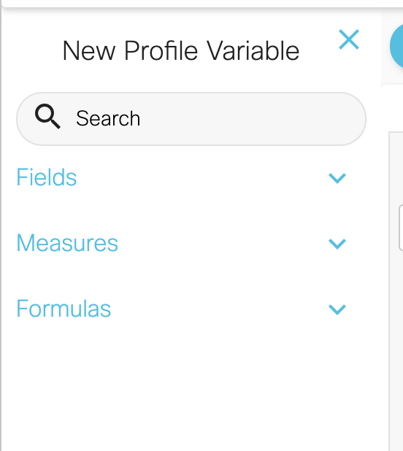
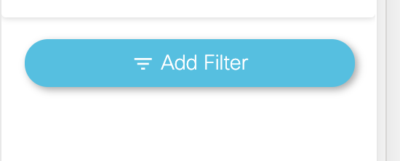
Visualization Variables
Filters:
Fields
Measures
Formulas
Enhanced Field

Slide 15
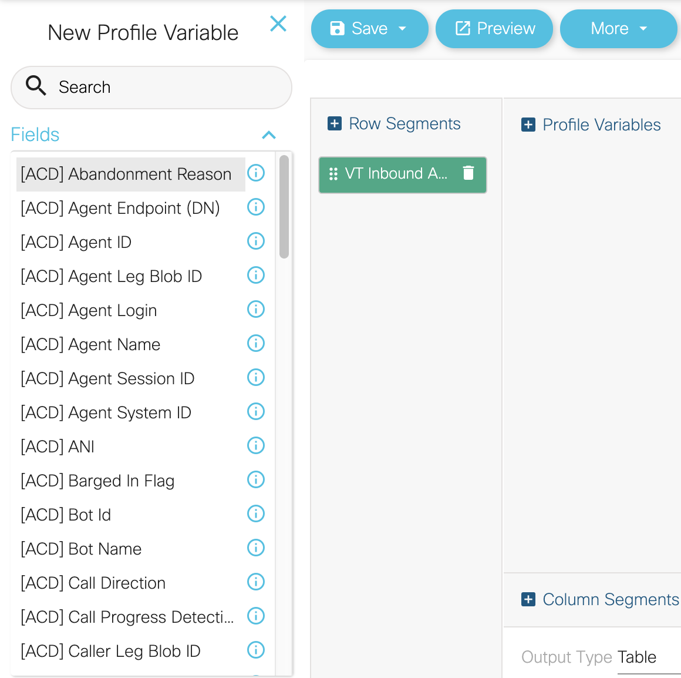
Fields
Only fields can be used for segmentation as shown.
- They are only textual values.
Fields can be combined with measures to create specific conditions for profiling variables.
DNIS, EntryPointName, QueueName and AgentName are all fields.
The order of the fields can be changed by dragging them to another position.
Remove a field by clicking the X that shows up on the field on the canvas when the mouse pointer is over it.

Slide 16
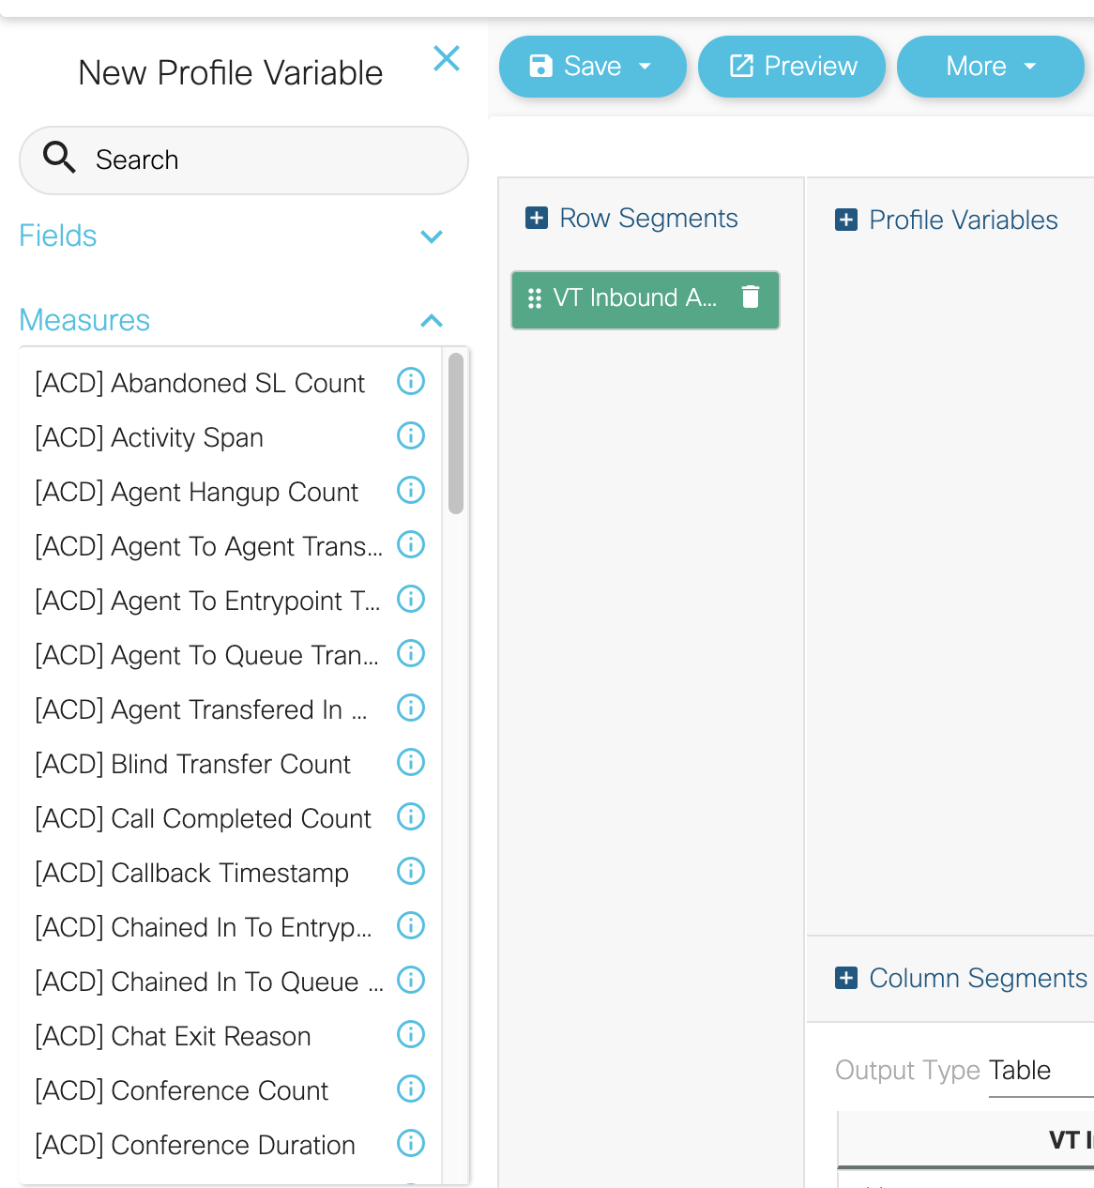
Measures
Measures are computed values that are predefined in the data dictionary.
They can only be used for profiling variables.
Remove measures the same way as a field and drag to change the location or order of the measures.
Measures can also be defined as a range (ex. ItemShipped between 50-100).

Slide 17
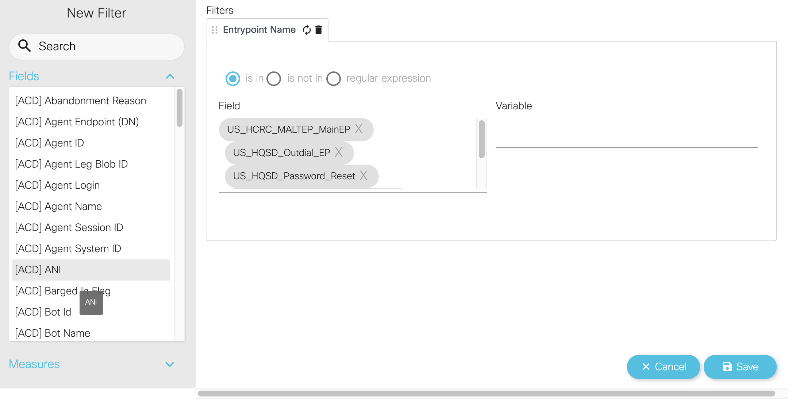
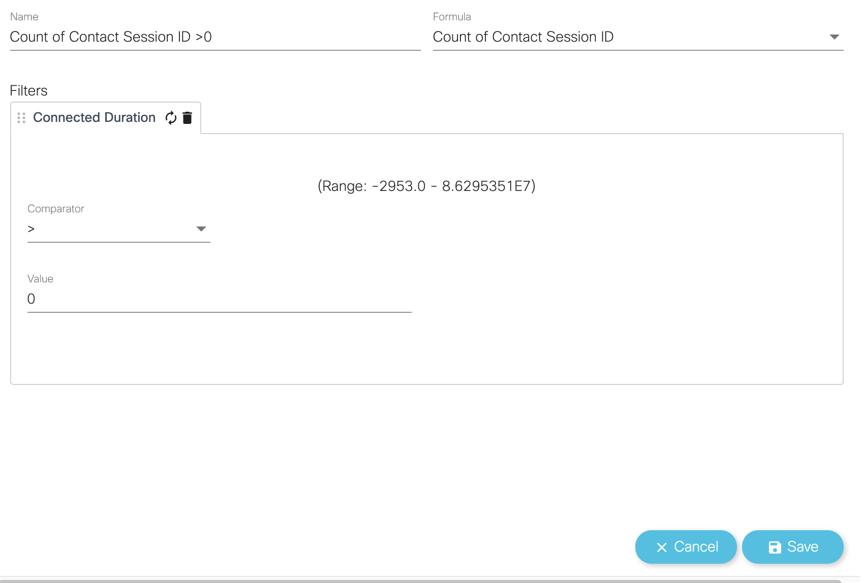
Filters
Filters are found on the left side of the visualization canvas/panel.
They set limits to the population of the data set.
Fields and Measures can be used as filters for the visualization.
Right click field or measure and Create Filter or drag to the filter panel.

Slide 18
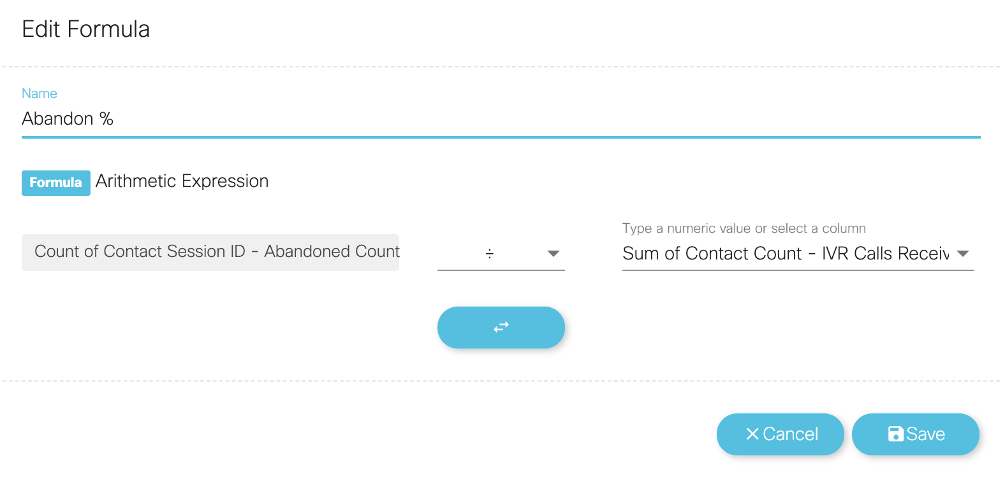
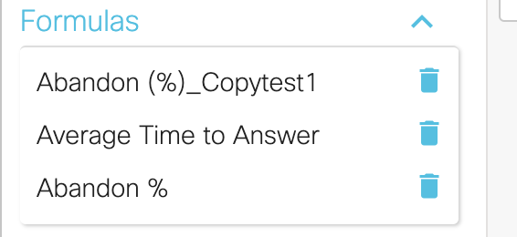
Formulas
The user can create formulas with an existing profiling variable or with a new profiling variable.
- Right click an existing PV and
click new profile variable.
Formulas can only have one resultant profiling variable.
Custom Formulas can be saved and reused across the Analyzer

Slide 19
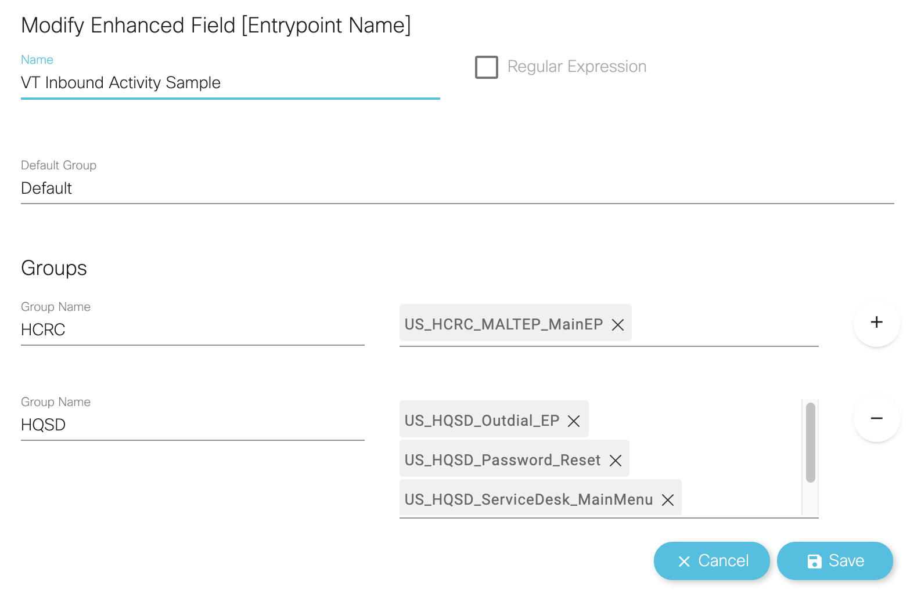
Enhanced Field
While creating or editing a visualization, users can create one or more enhanced fields to combine multiple values of a segmentation variable into one or more groups.
When the visualization is run, the values of all the segmentation variables in a group are combined into one row and the profiling variables for that visualization are computed for those segmentation values.

Slide 20
Creating a Visualization https://video.cisco.com/video/6186649839001

Slide 21
Analyzer Scheduler

Slide 22
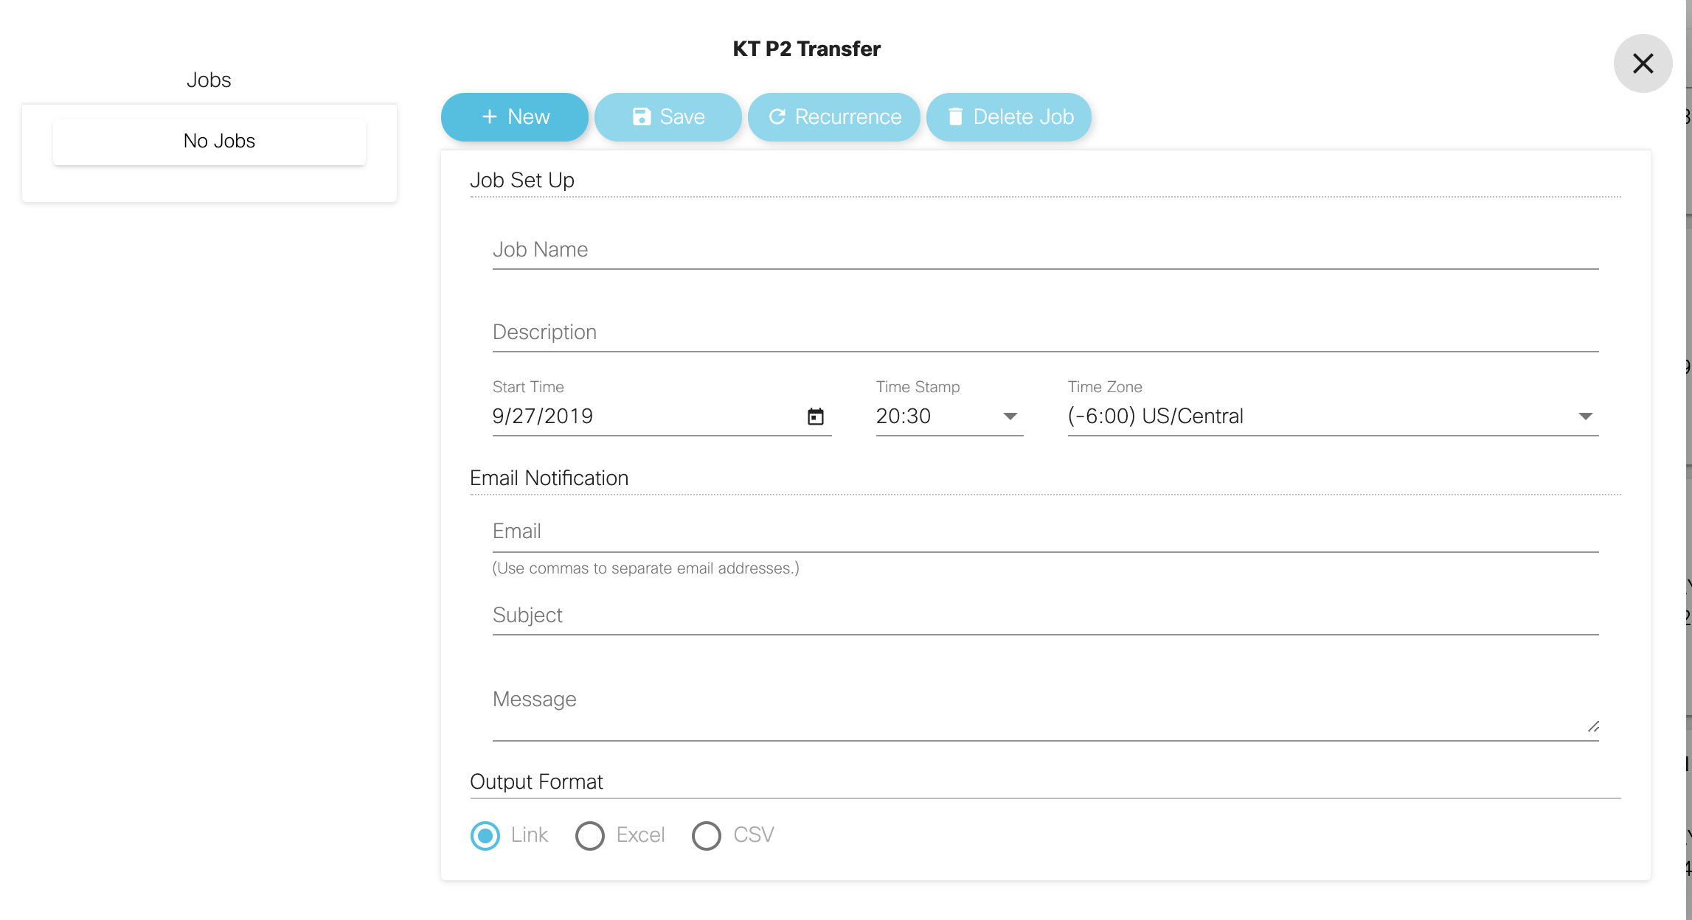
Analyzer Scheduler
Send the visualization or dashboard to any number of recipients in various formats
“The Job Scheduler” will allow the user to share the visualization with as many people as they want via an automated email job.
Advantages of the Scheduler:
Send visualizations periodically, on a recurring basis OR just one time (ad hoc)
Select the date, time, time zone and the recipients of the visualization
Complete the Subject and Message portion of the email and give the job a name and description (description is optional)
Output formats for visualizations
Excel file
CSV file
Link

Slide 23
Scheduling a report https://video.cisco.com/video/6186653328001

Slide 24
Analyzer Dashboards

Slide 25
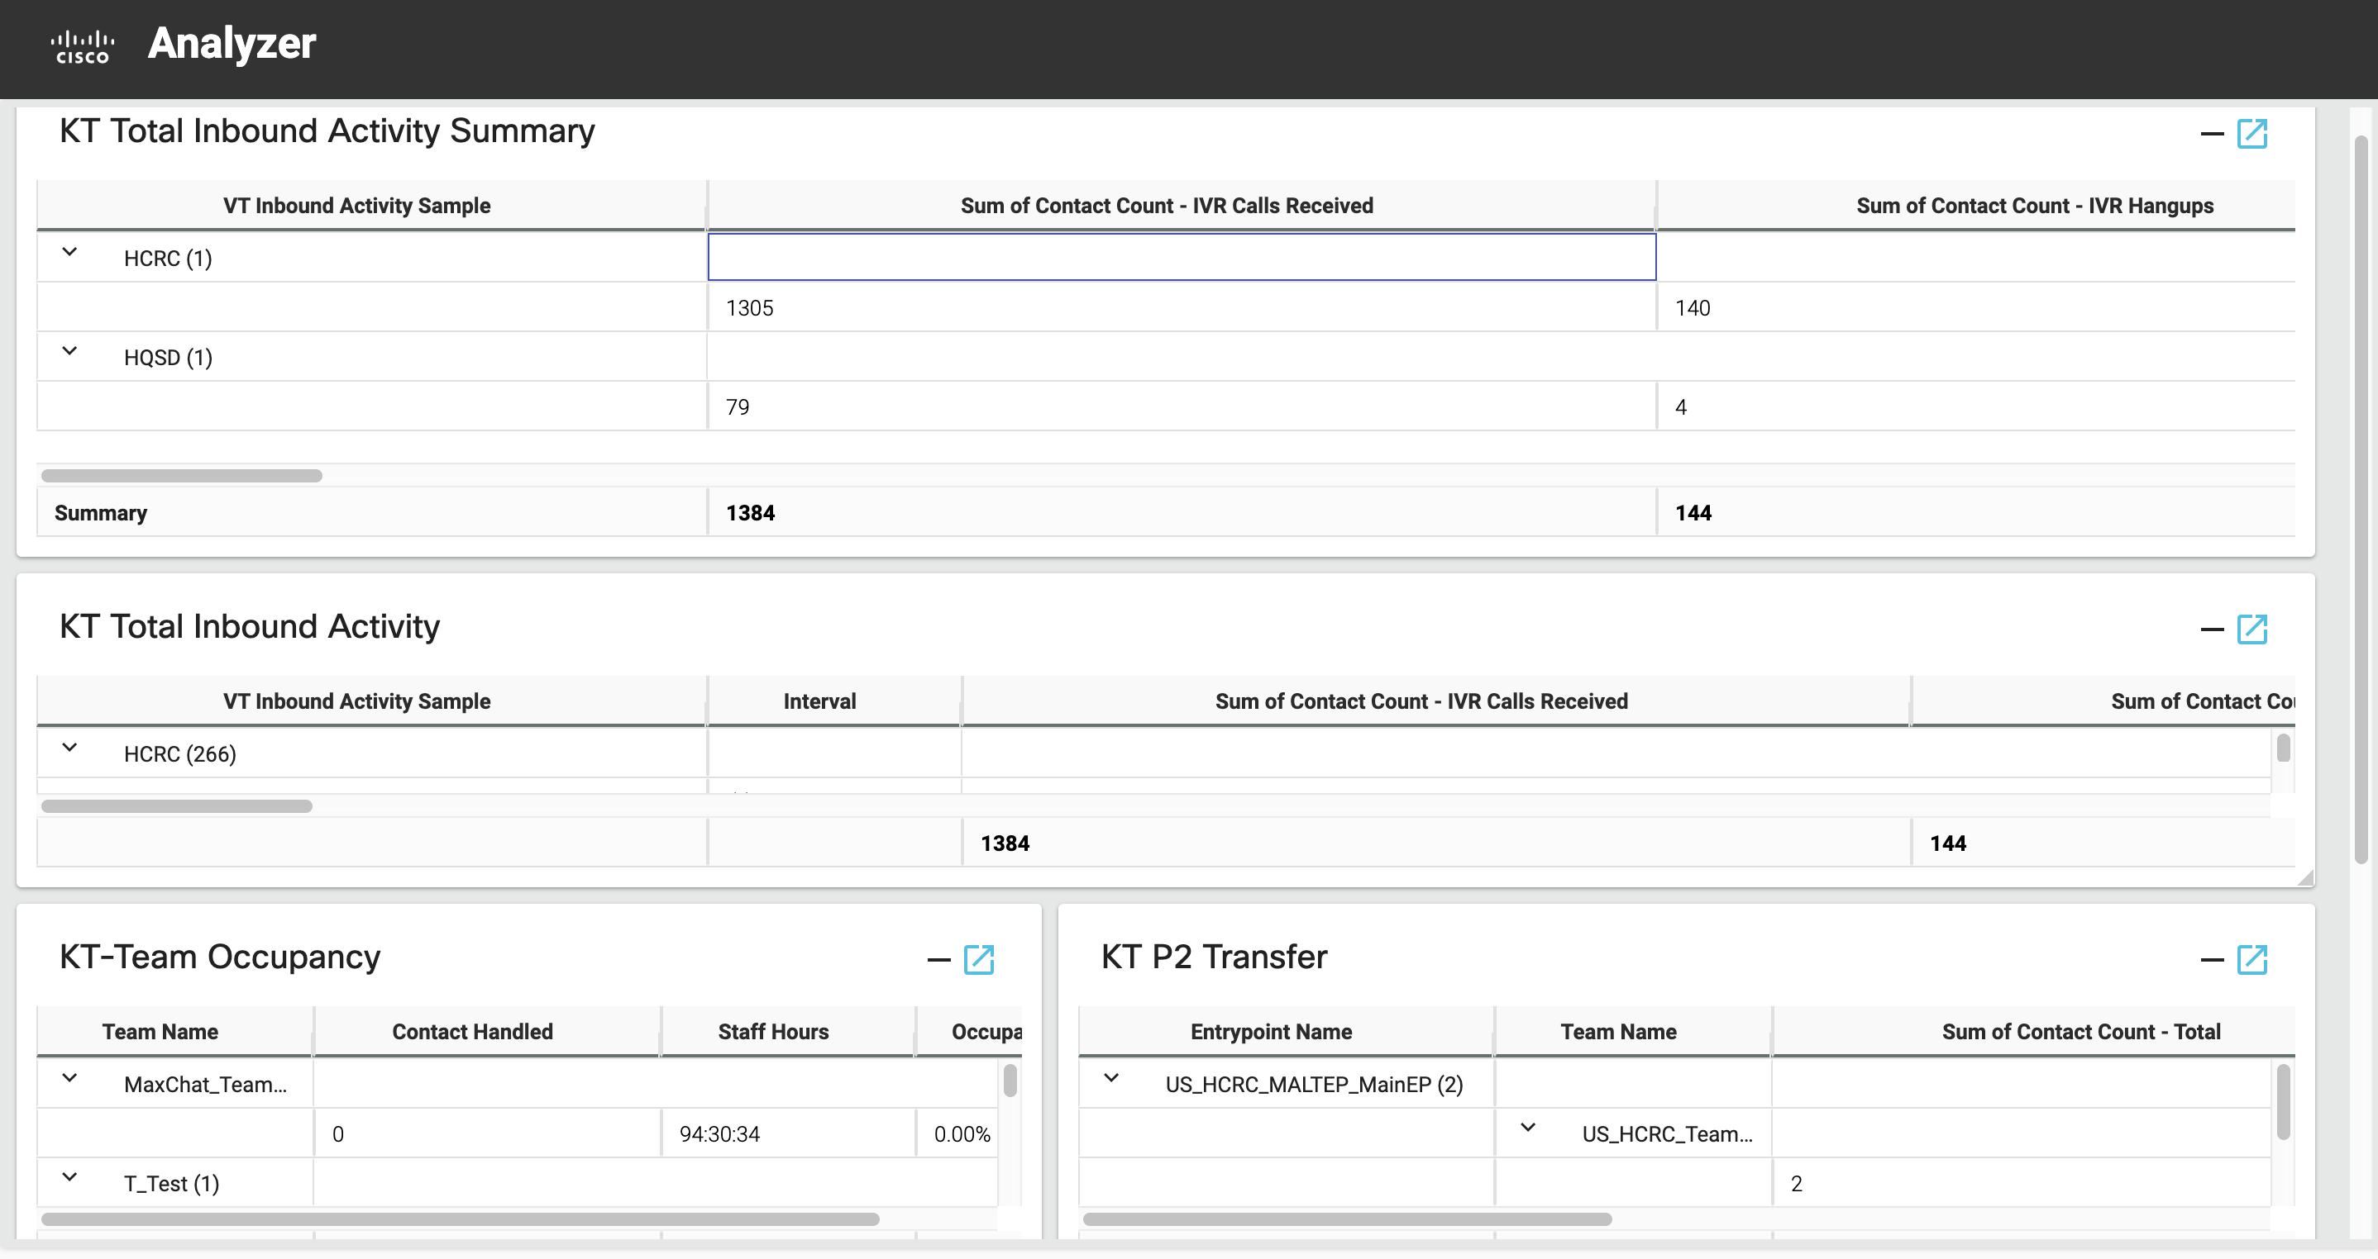
Analyzer Dashboards
Users can create a dashboard from the main page to create a custom visualization/reports canvas.
Dashboards allow more than one visualization to be presented at a time.
Pick visualizations from the panel on the left from any folder and drag to the canvas to edit.

Slide 26
Creating a Dashboard https://video.cisco.com/video/6186652858001

Slide 27
Drill Down

Slide 28

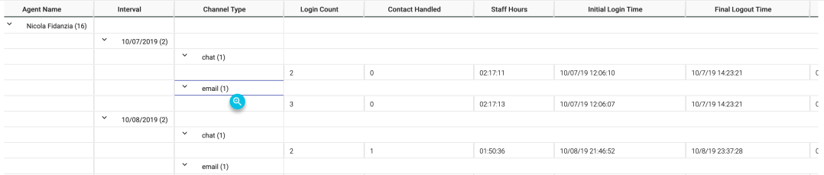

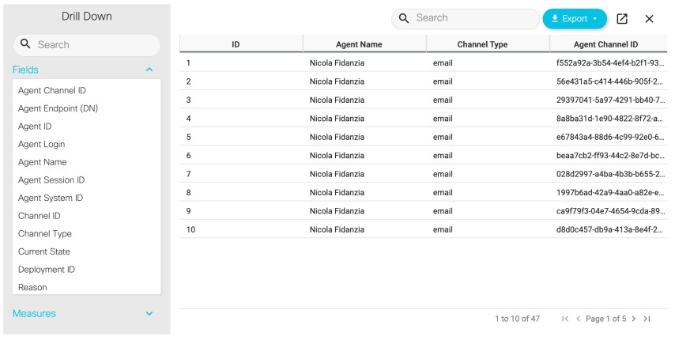
Visualization Portions
After running a visualization in table format, it is possible to drill down into a specific visualization component to see all the records that were involved in the computation of that portion of the visualization and perform further analytics on the data set

